Slide 1

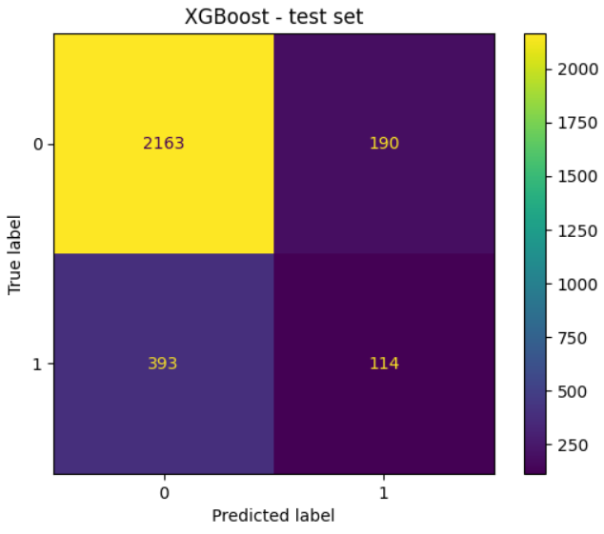
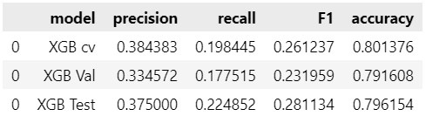
User Churn Project | Machine Learning Classification Results
Prepared for: Waze Leadership Team
The Waze data team is currently developing a data analytics project aimed at increasing overall growth by preventing monthly user churn on the Waze app. For the purposes of this project, churn quantifies the number of users who have uninstalled the Waze app or stopped using the app. Random Forest or XGBoost models can be used to inform larger business decisions. Our team sought to build them from the data provided for this project. This report offers details and key insights from Milestone 6.
Milestone 6 – Machine Learning Classification
🎯 Target Goal: Apply user data to build and analyze a machine learning classification model.
🎯 Methods:
Created features of interest to the stakeholders and business scenario
Built the classification models
Evaluated model performance
🎯 Impact: With enough data, machine learning model results can reveal important variable relationships and predict binary outcomes, which can inform decisions for marketing and product development.
Note: 1 = churned and 0 = retained
This model should not be used to make significant business decisions; however, it has valuable insights insofar as it demonstrated a great need for additional data (features) that correlates with user churn, and also a possible need to better define the user profile Waze seeks to target in their aim to increase overall growth by preventing monthly user churn.
Since engineered features are a proven valuable tool for improving the performance of ML models, the Waze team recommends a second iteration of the User Churn Project.
The efficacy of a classification model is determined by accuracy, precision, and recall scores; in particular, recall is essential to this model as it shows the number of churned users.
The best performing model, XGBoost still has mediocre precision (38% of its positive predictions are correct) and low recall, 22% of churned users identified. This means the model makes a lot of false negative predictions and fails to capture users who will churn.
Avg. driving speed, days after onboarding, percent sessions in last month are highest importance features in the model.

